Slide 1

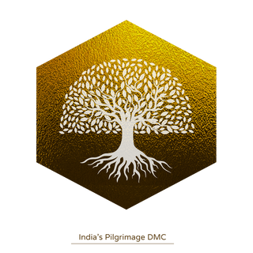





INDIA PILGRIMAGE
India’s Pilgrimage DMC
India Pilgrimage Presents
Unfolding the Evolution and Growth of Pilgrimage and Spiritual Tourism in India

Slide 2
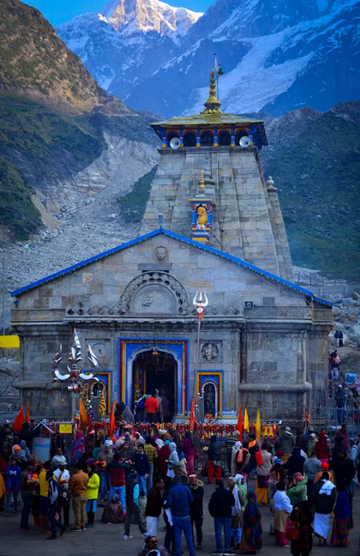
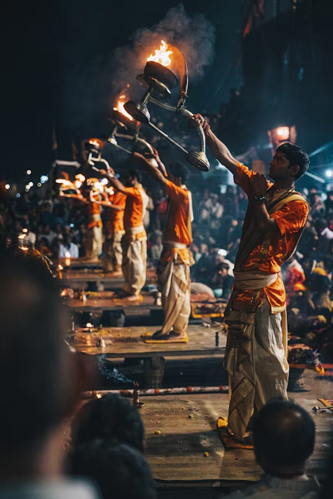




Introduction
🕉️Spiritual Tourism in India: A Timeless Calling Spiritual tourism, beyond its economic benefits, holds profound cultural and social significance.
🌀 In today’s fast-paced, hyper-connected world, people of all ages turn to spiritual journeys for:
Mindfulness, Healing, Conscious awakening
India: The Sacred Heart of Spiritual Travel
📍Over 450,000 religious and cultural heritage sites
India is a global epicenter for spiritual and pilgrimage tourism.
✨ While iconic destinations thrive...
🔍 Countless hidden sacred sites remain untapped,
holding immense potential for curated spiritual experiences.

Slide 3
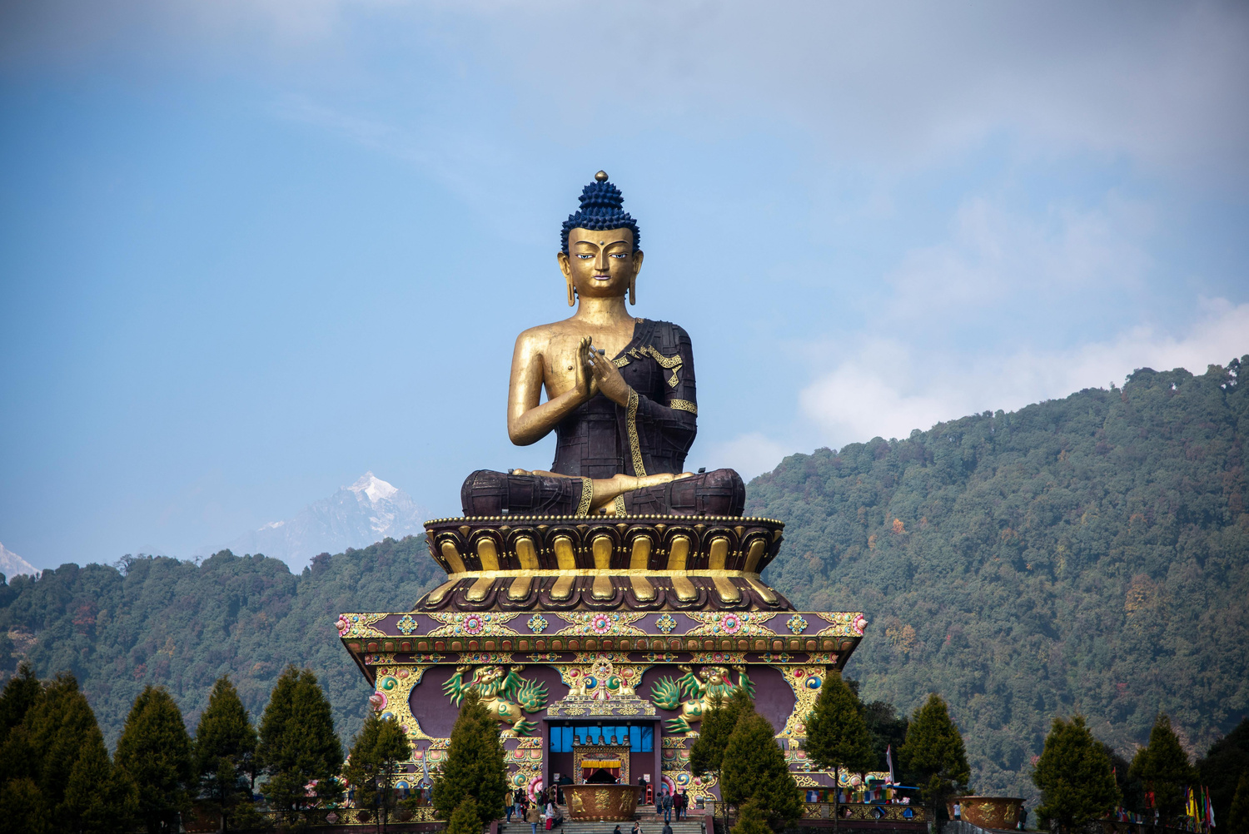
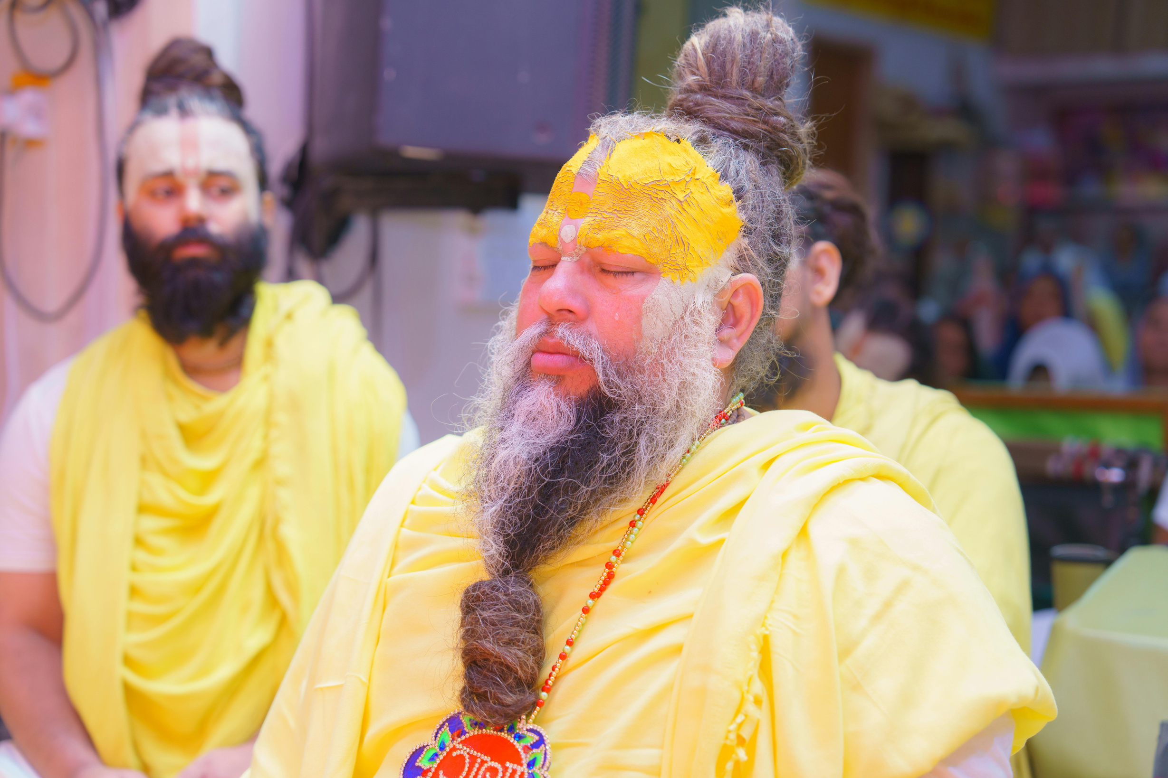
Why Spiritual Tourism Matters ?
• 60%+ of domestic tourism in India is driven by spiritual motivations.
• Post-pandemic trends show a resurgence in spiritual travel, especially among youth and solo travelers.
• Religious tourism is now integrating wellness, culture, and digital outreach, evolving into a modern, meaningful journey.

Slide 4





Key Statistics
1.4B
6.6M
10
72M
Domestic Pilgrims (2022)
Foreign Pilgrims (2022)
UNESCO Religious Sites
Varanasi YOY Growth
Over 1.4 billion Indian citizens embarked on religious journeys in 2022, a testament to the sector's scale.
India attracted 6.64 million international visitors specifically for religious tourism, indicating global appeal.
Ten out of India's 42 UNESCO World Heritage Sites are religious, underscoring their historical and cultural significance.
Tourist footfall in Varanasi surged from 6.8 million in 2019 to 72 million in 2022, an exponential increase.

Slide 5
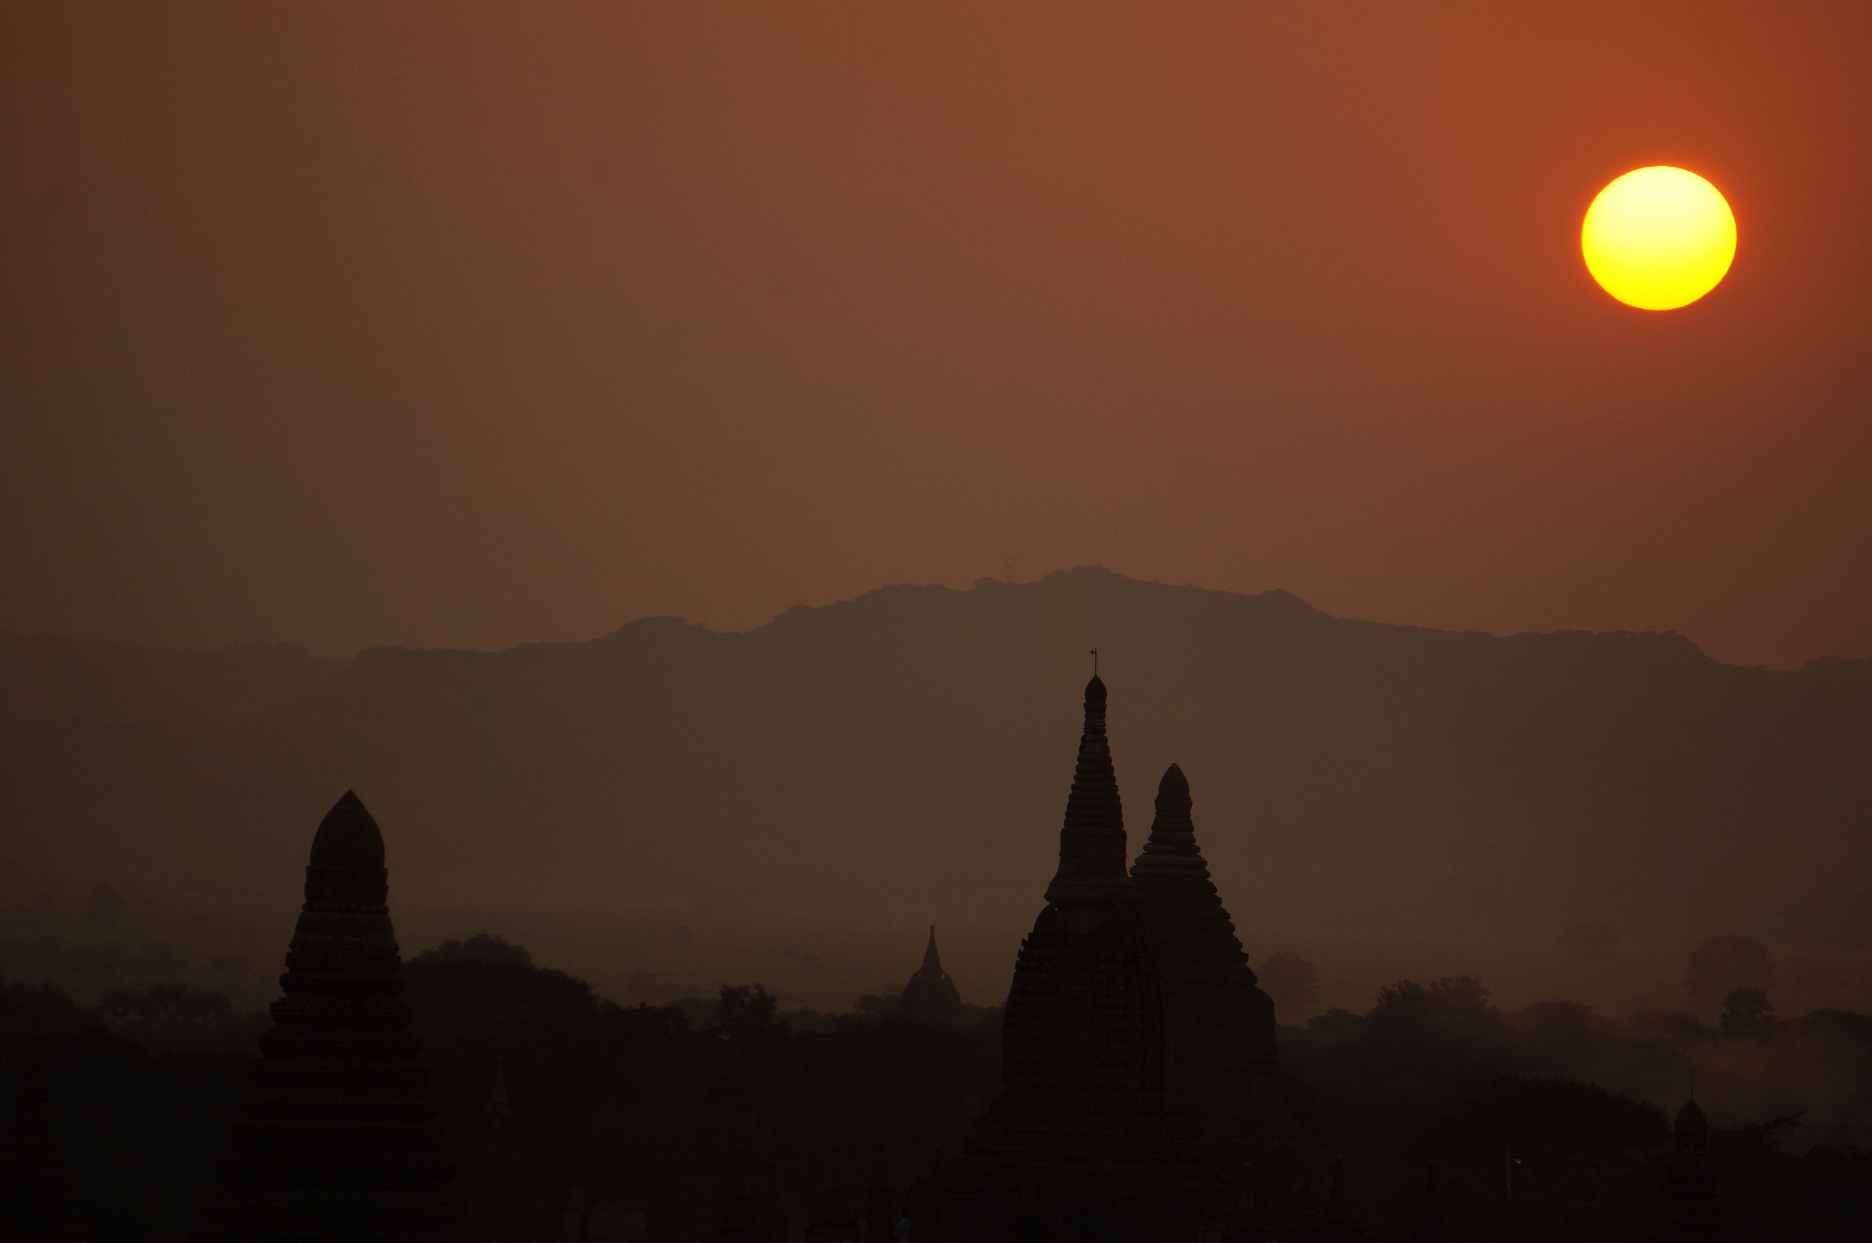
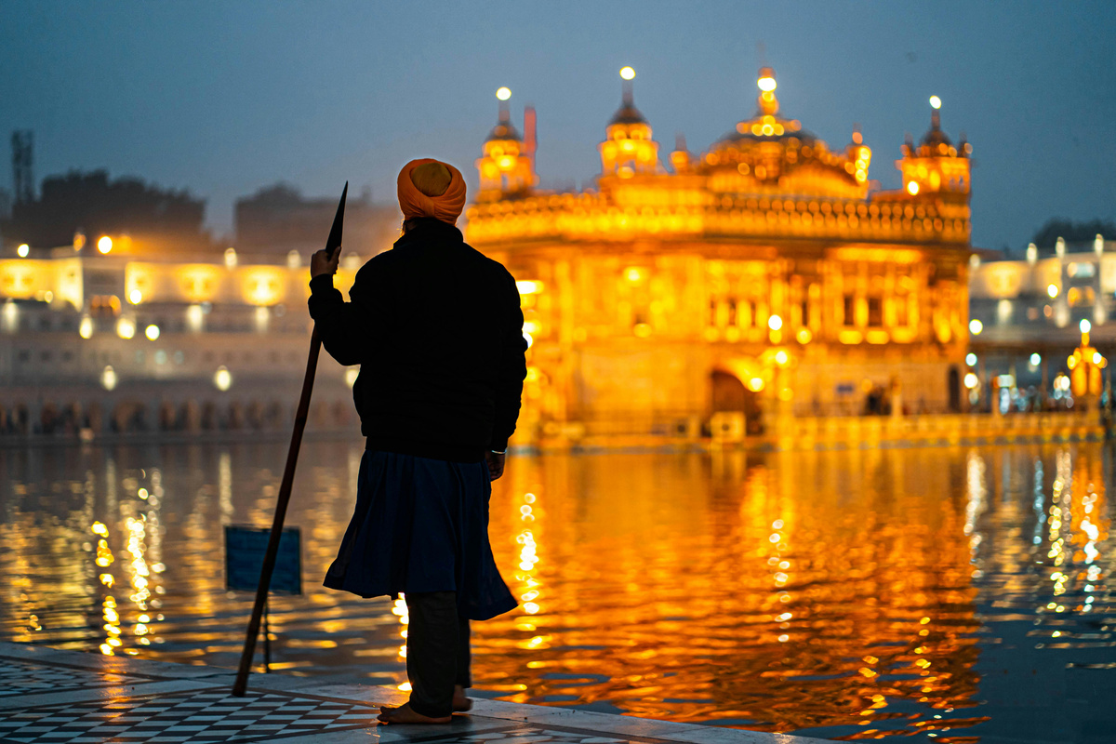
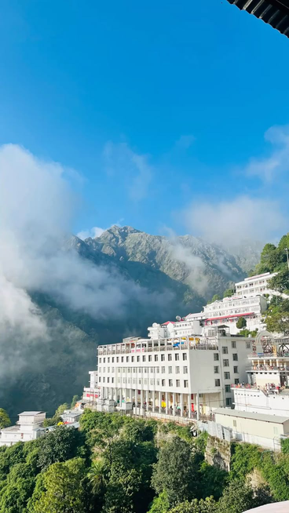
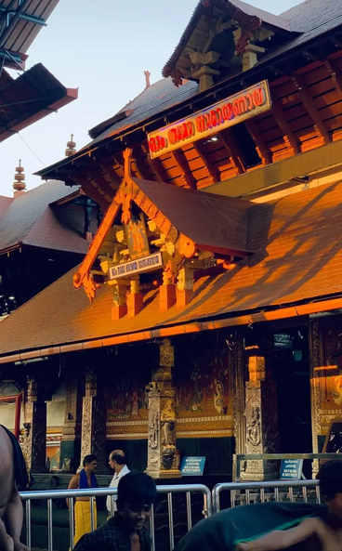
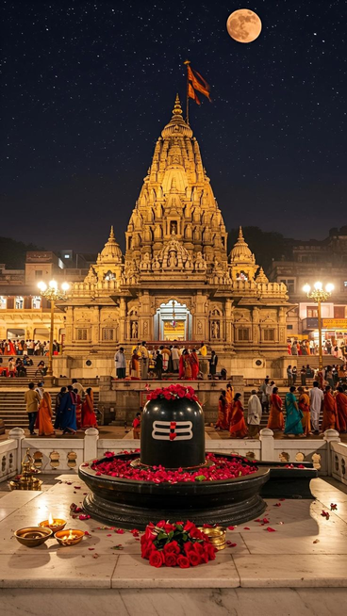
Top Pilgrimage Sites
Char Dham, Ajmer Sharif, Velankanni Church, Kashi Vishwanath, Tirupati Balaj
Golden Temple, Punjab
Vaishno Devi Shrine, J&K
Guruvayur Temple, Kerala
Dramatic increase in footfall post-pandemic
From 10–15K daily (pre-2020) to significantly higher numbers in 2022
More than 2x growth in daily visitors
Among the top visited religious sites

Slide 6



Emerging Trends in Spiritual Tourism
Youth & Solo Spiritual Travelers
Digital Transformation
Experiential Shift
  Influencer and Blogger Impact: Discovery of offbeat sacred sites through social media
  Virtual Pilgrimages: Live-streamed rituals, 360° temple tours, and online darshans flourished during the pandemic
  Spiritual exploration blended with self-discovery, discipline, and cultural immersion
  Interest in yoga, meditation, and wellness retreats at sacred destinations
  Travelers seek more than rituals, they desire cultural depth, authenticity, and personal transformation
  Visit to the lesser-known temples enhancing their faith

Slide 7


Pilgrimage Segments
Segment, Profile & Motivation
Spiritual seekers, often younger, looking for experimental and immersive experiences at lesser-known destinations
The Explorer
Solo Pilgrims
Seek introspection, personal growth, and resilience through spiritual journeys alone
Mass Organized Pilgrims
Travel in groups via packages; prefer community worship, guided tours, rituals, and shared experiences

Slide 8


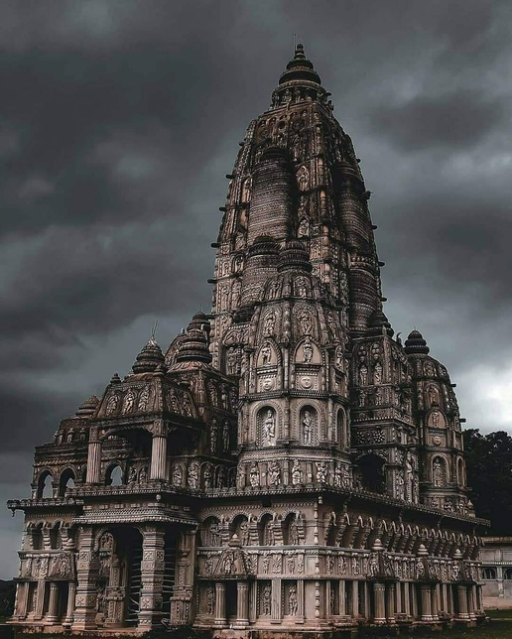
Story line for personalized pilgrimage experiences (“India Pilgrimage – Where Every Journey Becomes Sacred, Because It Begins With You.”)
Opportunities
Promoting hidden gems viz lesser- known temples across India

Slide 9

Strategic Growth:
Digital Tools & Outreach
Digital Tools for Pilgrims
Content & Outreach
  Integration of technology: Podcasts, real-time maps, darshan timings, rules, and seamless ticketing solutions.
  Travel platform integration: Collaborations for easy booking and planning.
  Tier-2 & Tier-3 city interest: Explosive growth in spiritual travel from smaller cities (Ayodhya: ↑585%, Ujjain: ↑359%, Badrinath: ↑343% in 2023 vs. 2022).
  Highlighting stories: Showcasing traditions and unique experiences of lesser-known sites.
  Local collaboration: Partnering with local stakeholders and temple trusts for enhanced visibility and authentic representation.

Slide 10




Call to Action: Unlocking India's Spiritual Potential
To truly harness India’s spiritual wealth, we propose a comprehensive outreach approach:
Curated Pilgrimage Circuits
Tailored Packages
Create bespoke travel packages that promote lesser-known destinations, ensuring unique and personalized experiences for pilgrims.
Develop diverse circuits catering to various spiritual interests and durations, blending popular and unexplored sites.
Culture & History Integration
Digital Storytelling
Combine faith journeys with rich cultural and historical explorations, offering a holistic and enriching experience.
Encourage the use of digital platforms to preserve and share traditional narratives in a modern, engaging context.

Slide 11





Let’s Work Together
Contact Us!
Vijay Bahukhandi: +91 92059 08208
Naveen Kumar: +91 95990 52395
vijay@indiapilgrimage.in
naveen@indiapilgrimage.in
We at India Pilgrimage are committed to bridging tradition with transformation. Join us in promoting and preserving India’s sacred landscape!
www.indiapilgrimage.in

